Slide 1





TWITTER SENTIMENT ANALYSIS
By: Raghad Al-moqhim & Lina Al-fawazn
supervisor: Dr. Samia Dardouri.

Slide 2

TABLE OF CONTENT
Introduction
Problem
Objective
Methodology
Result & Discussion
Conclusion & recommendation

Slide 3
INTRODUCTION
Twitter sentiment analysis identifies negative, positive, or neutral emotions within the text of a tweet. It is a text analysis using natural language processing (NLP) and machine learning (ML). It identifies and extracts subjective information from original data, providing a company with a better understanding of the social sentiment of its brand, product, or service.

Slide 4


PROBLEM
The amount of content generated by users is too vast for a normal user to analyze.
So, there is a need to automate this.
A Twitter sentiment analysis is the process of determining the emotional tone behind a series of words, specifically on Twitter. A sentiment analysis tool is an automated technique that extracts meaningful customer information related to their attitudes, emotions, and opinions. No matter how it is ambiguous, complicated, or confusing.

Slide 5




Accurately extract people's opinions from a large number of unstructured review texts and classify them into sentiment classes, i.e., positive, negative, or neutral.
OBJECTIVES
Allows you to keep track of what's being said about your product or service on social media.
Can help you detect angry customers or negative mentions before they escalate.
Manage crisis better.

Slide 6

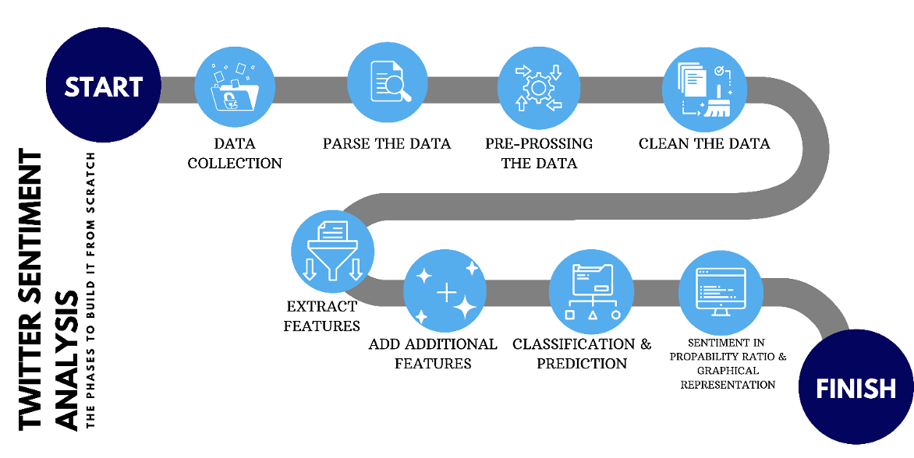
MEMETHODOLOGY

Slide 7
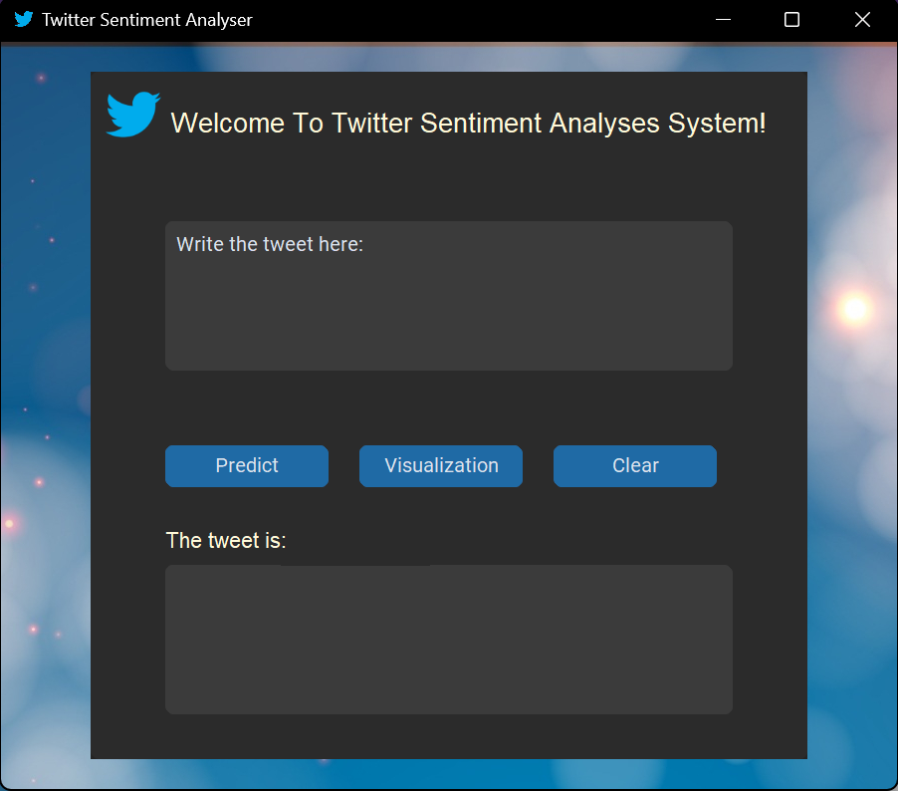
RESULTS

Slide 8


LET'S TRY TOGETHER!
فيصل بن فرحان
@FaisalbinFarhan
During my visit to #Mexico, I held fruitful meetings with senior officials on development of bilateral relations in the interest of the two countries. Both countries will play vital roles to promote joint action for development and prosperity, regionally and globally.
16:10 PM · 7/16/22 ·
Your Translate from Arabic

Slide 9
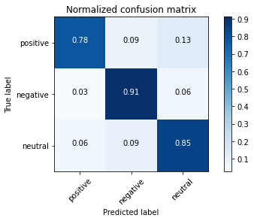

RESULTS
The accuracy performance of an algorithm (Naive Bayesian) specified through the confusion matrix is approximately 85%

Slide 10
Recommendation includes working not only in the English language but in other regional languages too. Also, it will include analysis of complex emotions like sarcasm and generate a hybrid classifier to get the best accuracy.
CONCLUSION
& RECOMMENDATIONS
Twitter is full of useful data that can be easily extracted for your organization’s benefit. With the help of our project, you can extract subjective data from twitter mentions, profiles, trending topics and more as data that can be analyzed.

Slide 11
Thank you...

